Slide 1

College space
A new flutter project
ANKIT YADAV
DEVENDRA KUMAR GUPTA

Slide 2
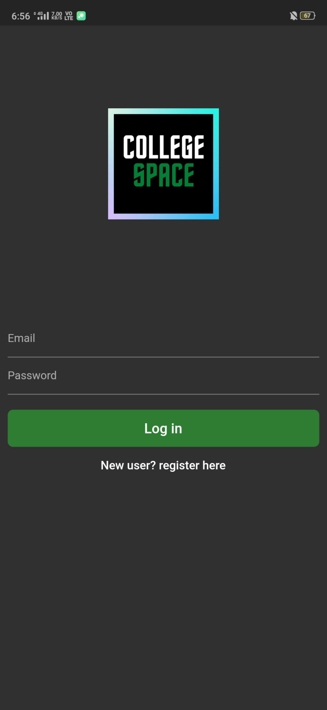
Welcome screen
App welcomes you
with a login screen.
If you are a new user,
you have to register first.

Slide 3
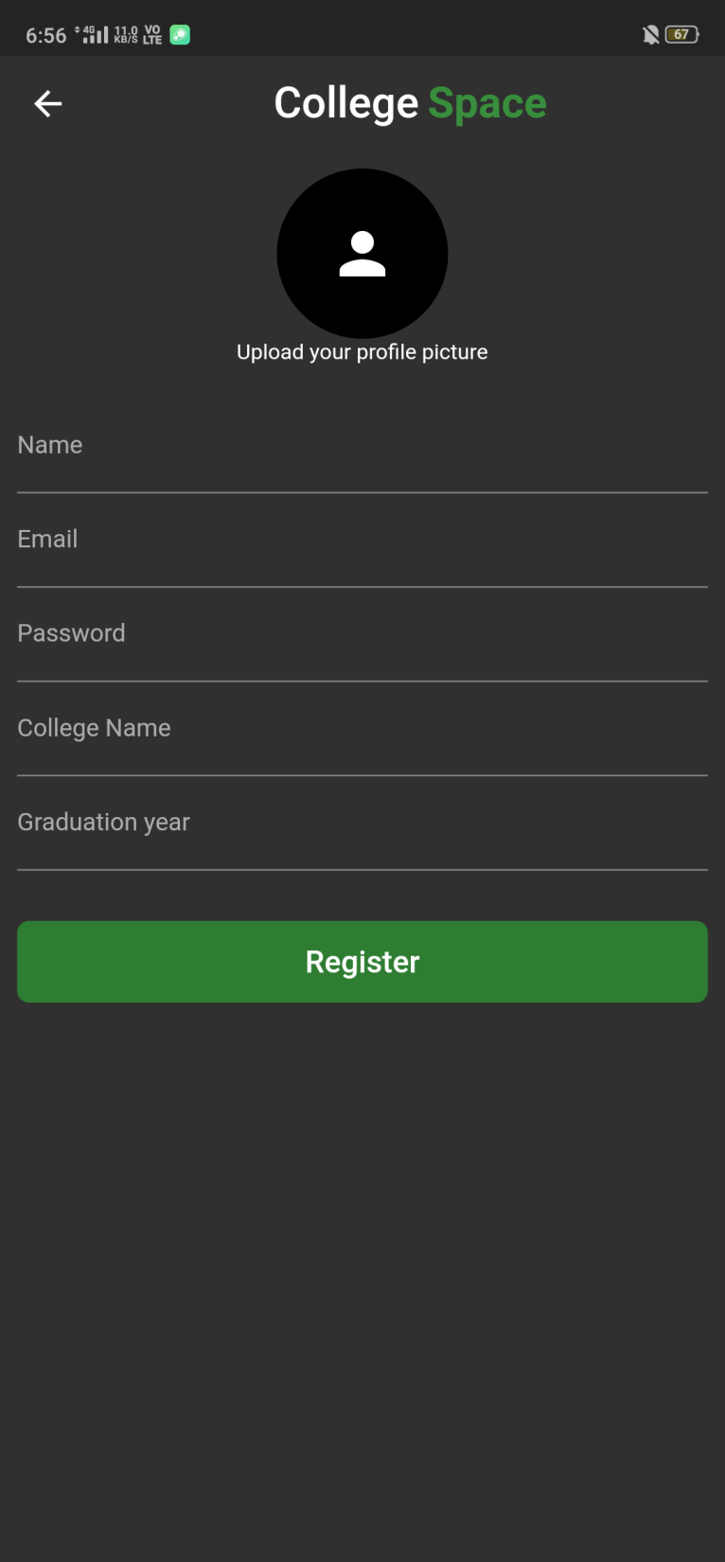
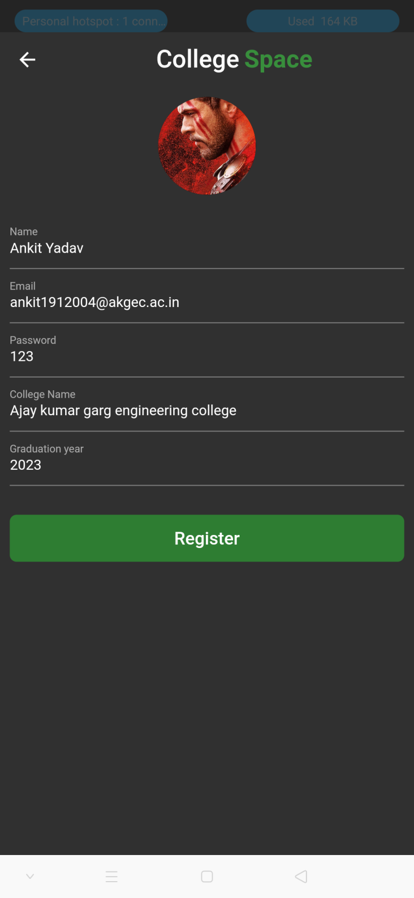
Register

Slide 4
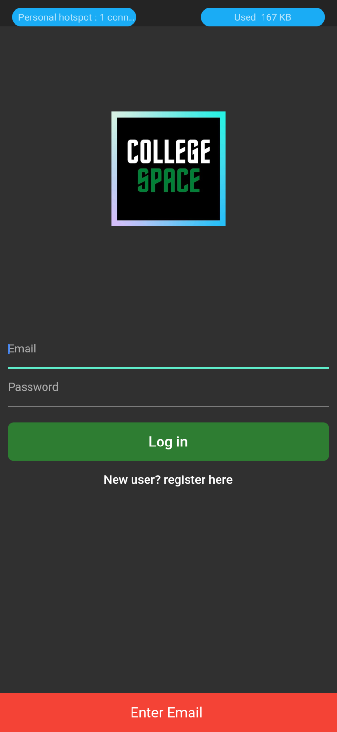
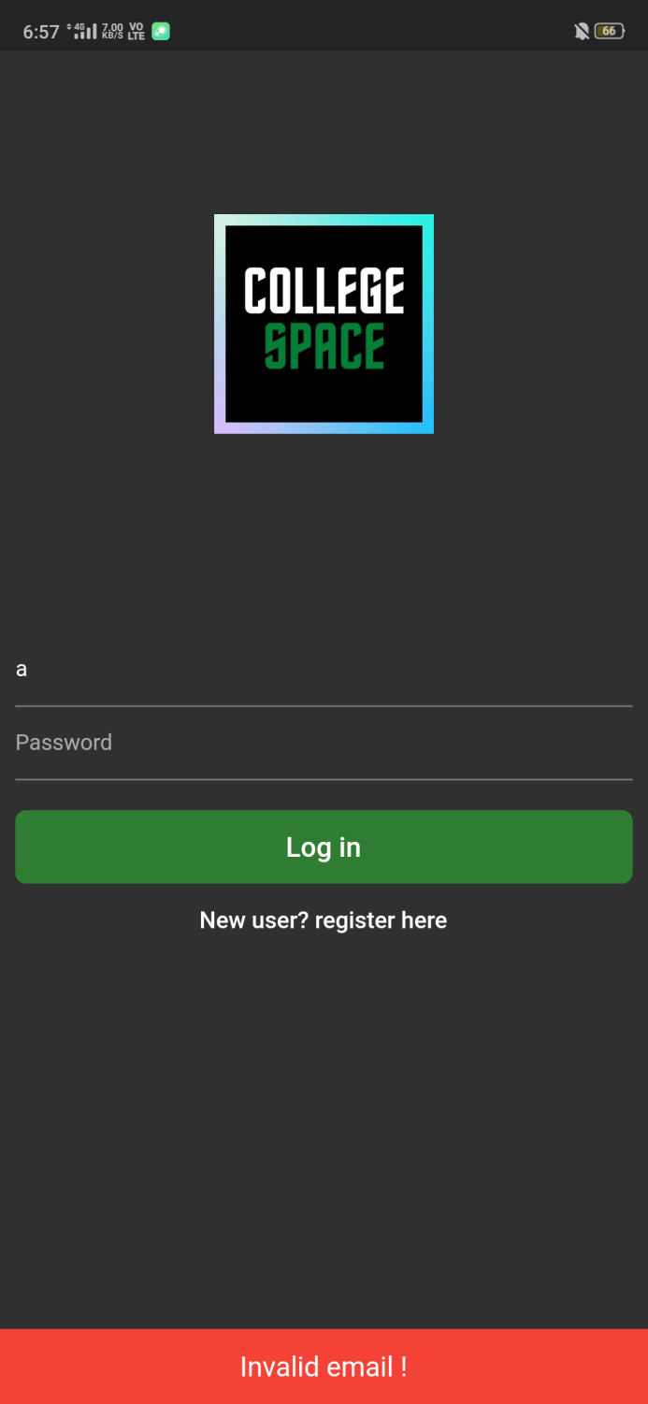
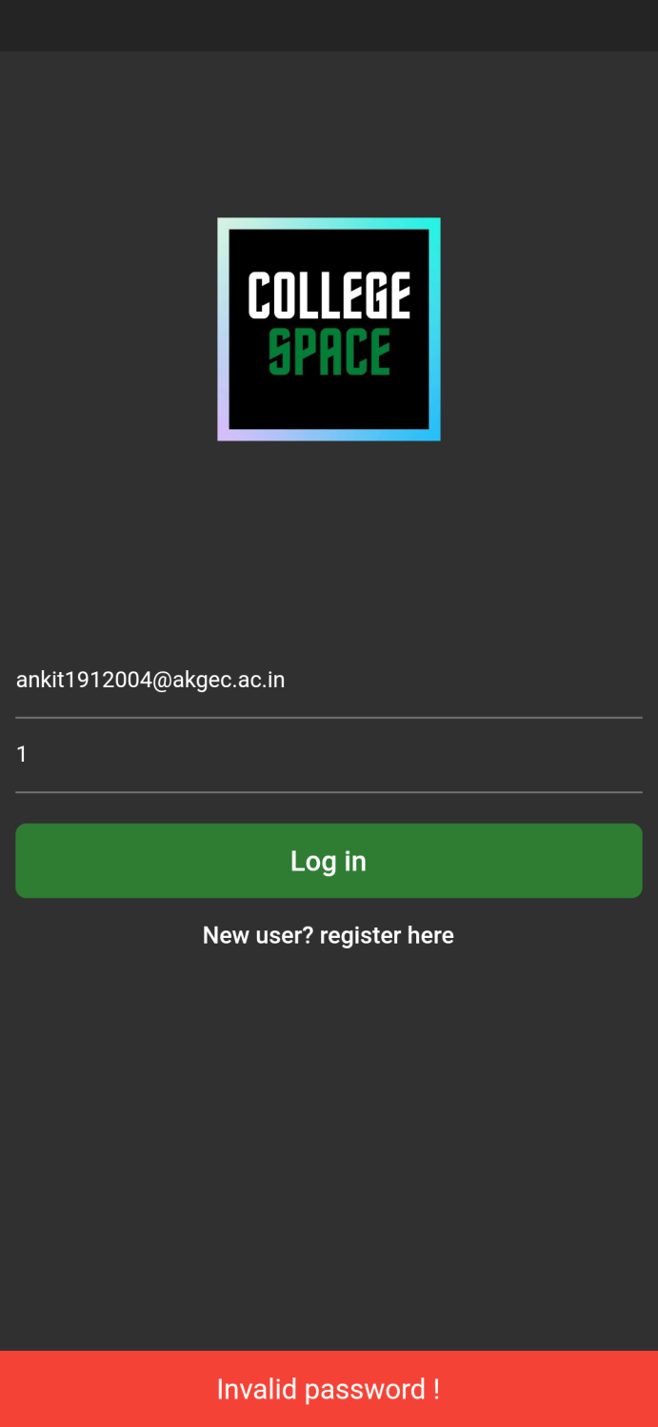
LOGIN

Slide 5
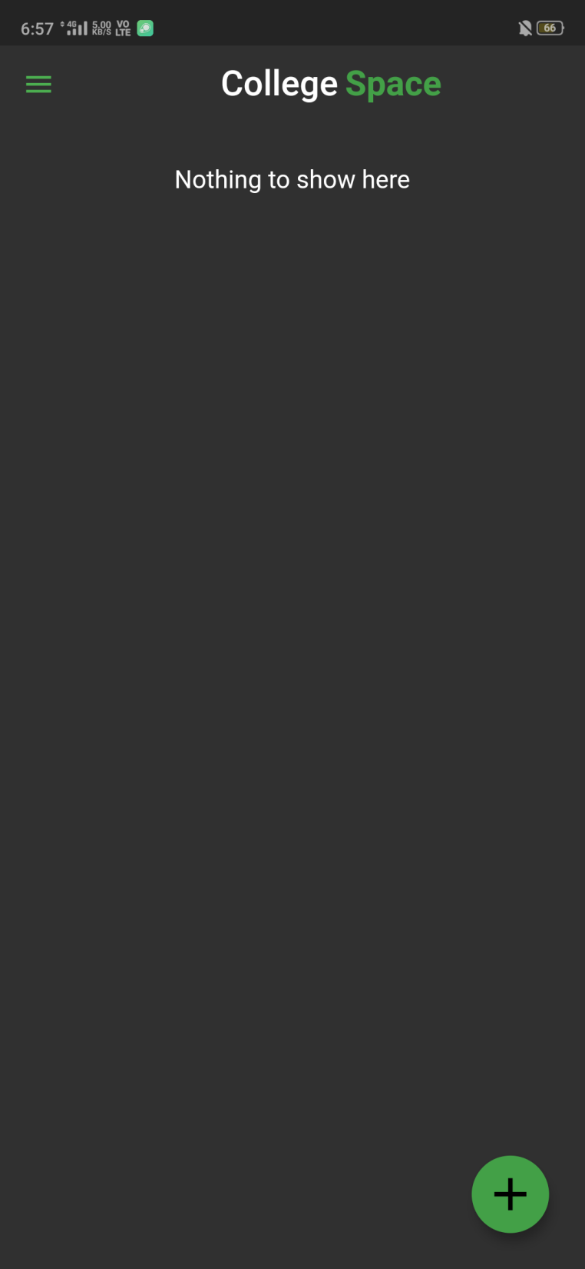
Welcome Home Screen
Initially it will be all empty
With an app bar, a drawer button
and an add button

Slide 6
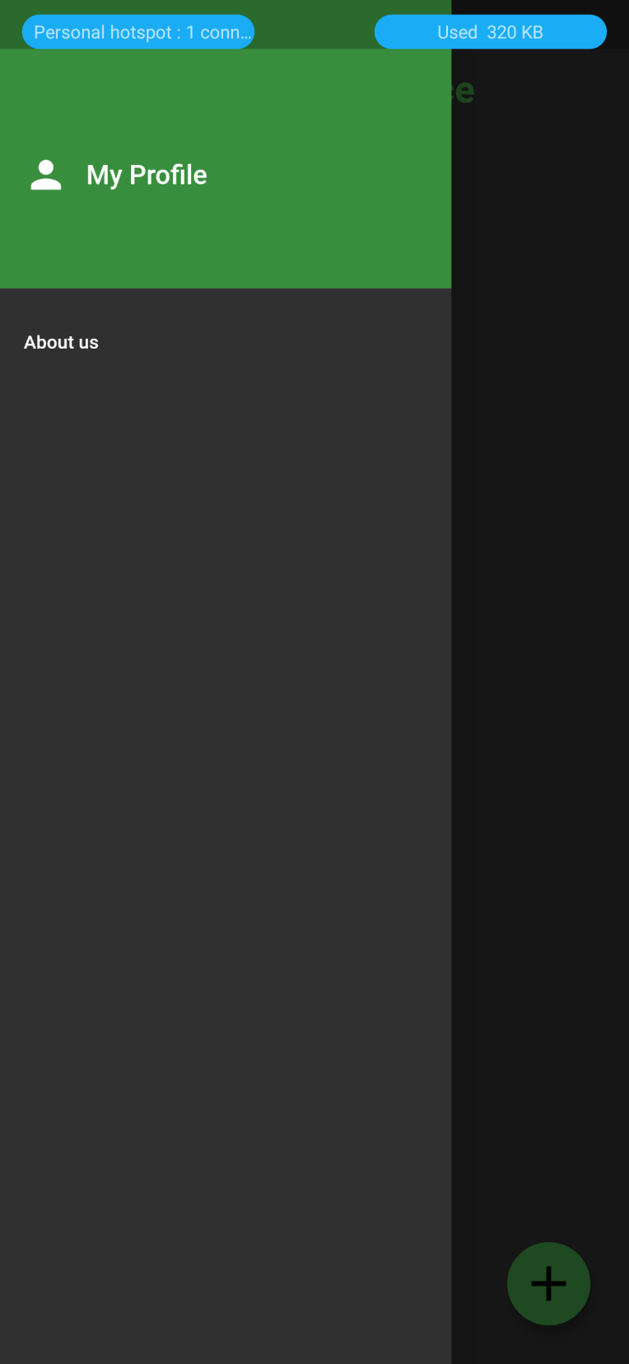
Drawer
Drawer consists of two buttons –
My profile
About us
My profile button leads you to your profile page
And About Us button will take you to the developers’
Detail page

Slide 7
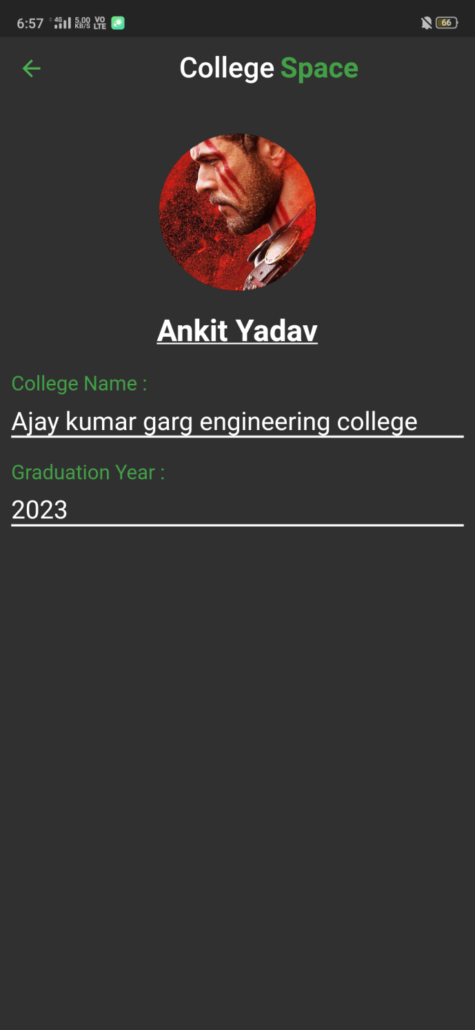
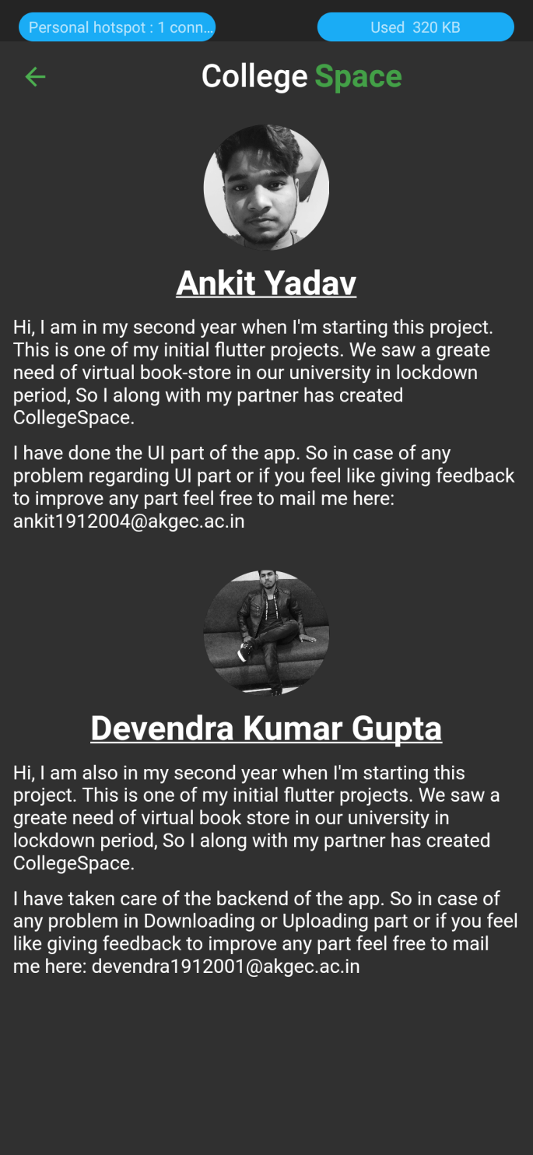
My profile and About us

Slide 8
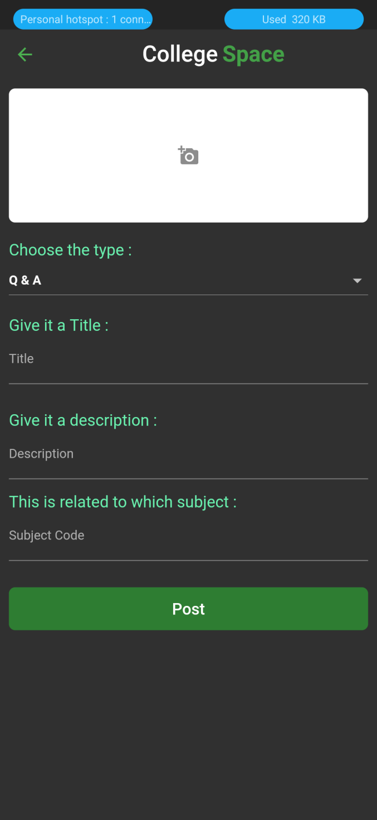
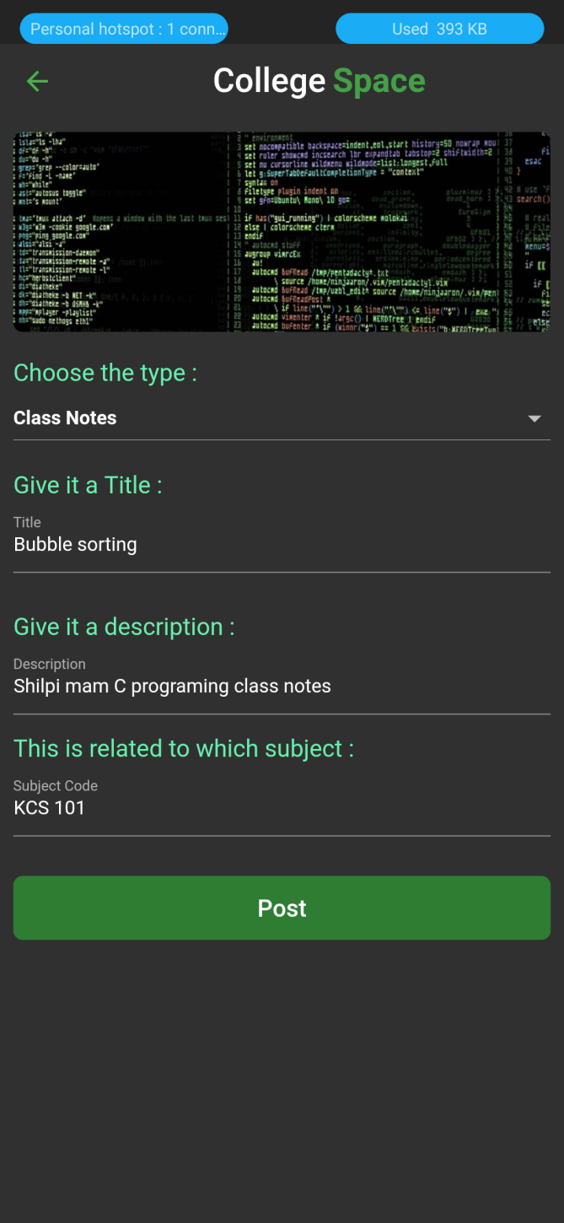
Add button

Slide 9
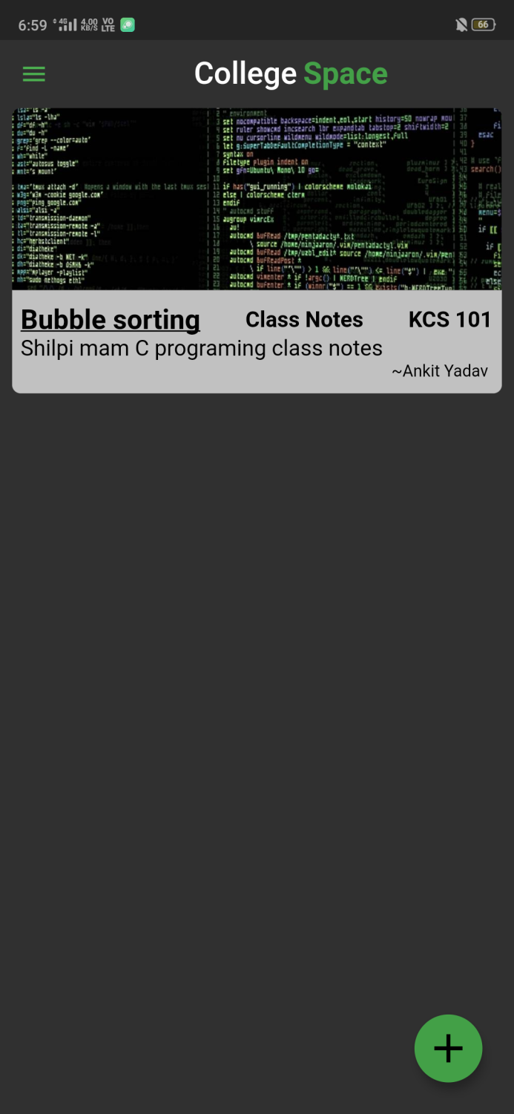
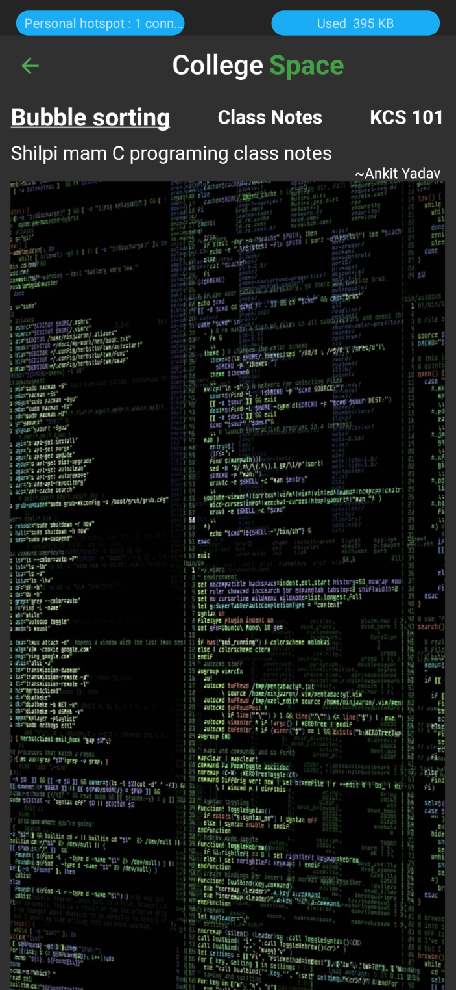
Home Page

